Slide 1
￼￼￼￼ 𝓜𝓘𝓝𝓘 𝓟𝓡𝓞𝓙𝓔𝓒𝓣
TITLE
student database management system
Batch member
Praveen.G (111919104098)
Justus Kevin.T (111919104052)
Ramanan.K (111919104108)

Slide 2
Introduction:
The Student Database Management System can handle all the details about a student .
The details include student’s identity number , first name , surname, address, phone number, age, gender and Date of Birth.
These details can be manipulated by the operations such as insertion , deletion , updating , searching and displaying .

Slide 3
HARDWARE AND SOFTWARE USED:
HARDWARE:
4 GB RAM
5 GB Free disk space
X86 64-bit CPU(Intel/AMD architecture)
SOFTWARE:
DB Browser SQLite(A visual tool to access the database)
Tkinter (Python package for GUI designing)
Pyinstaller (Python package for converting the python files to executable files)
Windows 7 or 10

Slide 4
SOURCE CODE:
FRONT END:
from tkinter import*
import tkinter.messagebox
import Student_Database_BackEnd
class Student:
def __init__(self,root):
self.root =root
self.root.title("Student Database Management Systems")
self.root.geometry("1350x750+0+0")
self.root.config(bg="cadet blue")

Slide 5
StudentID = StringVar()
FirstName = StringVar()
SurName = StringVar()
DOB = StringVar()
Age = StringVar()
Gender = StringVar()
Address = StringVar()
PhoneNumber = StringVar()
#==============FUNCTIONS==========
def Exit_Option(): Exit_Option=tkinter.messagebox.askyesno("Student Database Management Systems","Are sure you want to exit ?")
if Exit_Option > 0:
root.destroy()
return

Slide 6
def ClearData():
self.txtStudentID.delete(0,END)
self.txtFirstName.delete(0,END)
self.txtSurName.delete(0,END)
self.txtDOB.delete(0,END)
self.txtAge.delete(0,END)
self.txtGender.delete(0,END)
self.txtAddress.delete(0,END)
self.txtPhoneNumber.delete(0,END)
def AddData():
if(len(StudentID.get()) != 0):
Student_Database_BackEnd.AddStudentRecord( StudentID.get(), FirstName.get(), SurName.get(), DOB.get(), Age.get(), Gender.get(), Address.get(), PhoneNumber.get())
studentlist.delete(0, END)
studentlist.insert(END, ( StudentID.get(), FirstName.get(), SurName.get(), DOB.get(), Age.get(), Gender.get(), Address.get(), PhoneNumber.get()))

Slide 7
def DisplayData():
studentlist.delete(0,END)
for row in Student_Database_BackEnd.ViewData():
studentlist.insert(END,row,str(""))
def StudentRecord(event):
global sd
searchStd = studentlist.curselection()[0]
sd = studentlist.get(searchStd)
def StudentRecord(event):
global sd
searchStd = studentlist.curselection()[0]
sd = studentlist.get(searchStd)

Slide 8
self.txtStudentID.delete(0,END)
self.txtStudentID.insert(END,sd[1])
self.txtFirstName.delete(0,END)
self.txtFirstName.insert(END,sd[2])
self.txtSurName.delete(0,END)
self.txtSurName.insert(END,sd[3])
self.txtDOB.delete(0,END)
self.txtDOB.insert(END,sd[4])
self.txtAge.delete(0,END)
self.txtAge.insert(END,sd[5])
self.txtGender.delete(0,END)
self.txtGender.insert(END,sd[6])
self.txtAddress.delete(0,END)
self.txtAddress.insert(END,sd[7])
self.txtPhoneNumber.delete(0,END)
self.txtPhoneNumber.insert(END,sd[8])

Slide 9
def DeleteData():
if(len(StudentID.get()) != 0):
Student_Database_BackEnd.DeleteRecord(sd[0])
ClearData()
DisplayData()
def SearchDatabase():
studentlist.delete(0,END)
for row in Student_Database_BackEnd.SearchData( StudentID.get(), FirstName.get(), SurName.get(), DOB.get(), Age.get(), Gender.get(), Address.get(), PhoneNumber.get()):
studentlist.insert(END,row,str(""))
def Update():
if(len(StudentID.get()) != 0):
Student_Database_BackEnd.DeleteRecord(sd[0])
if(len(StudentID.get()) != 0):
Student_Database_BackEnd.AddStudentRecord( StudentID.get(), FirstName.get(), SurName.get(), DOB.get(), Age.get(), Gender.get(), Address.get(), PhoneNumber.get())

Slide 10
studentlist.delete(0,END)
studentlist.insert(END, ( StudentID.get(), FirstName.get(), SurName.get(), DOB.get(), Age.get(), Gender.get(), Address.get(), PhoneNumber.get()))
#============FRAMES==================
MainFrame = Frame(self.root,bg="cadet blue")
MainFrame.grid()
TitFrame = Frame(MainFrame,bd=2,padx=54,pady=8,bg="Ghost White",relief=RIDGE)
TitFrame.pack(side=TOP)
self.lblTit = Label(TitFrame,font = ('Edwardian Script ITC',47,'bold'),text=" Student Database Management Systems ",bg="Ghost White")
self.lblTit.grid()
ButtonFrame = Frame(MainFrame,bd=2,width=1350,height=70,padx=18,pady=10,bg="Ghost White",relief=RIDGE)

Slide 11
ButtonFrame.pack(side=BOTTOM)
DataFrame = Frame(MainFrame,bd=1,width=1300,height=400,padx=20,pady=20,relief=RIDGE,bg="cadet blue")
DataFrame.pack(side=BOTTOM)
DataFrameLEFT = LabelFrame(DataFrame,bd=1,width=1000,height=600,padx=20,relief=RIDGE,bg="Ghost White",font = ('Edwardian Script ITC',30,'bold'),text="Student Info\n")
DataFrameLEFT.pack(side=LEFT)
DataFrameRIGHT = LabelFrame(DataFrame,bd=1,width=450,height=300,padx=31,pady=3,relief=RIDGE,bg="Ghost White",font = ('Edwardian Script ITC',30,'bold'),text="Student Details\n")
DataFrameRIGHT.pack(side=RIGHT)
#====LABELS AND ENRTY WIDGET=======
self.lblStudentID = Label(DataFrameLEFT,font=('arial',25,'bold'),text="Student ID :",padx=2,pady=2,bg="Ghost White")
self.lblStudentID.grid(row=0,column=0,sticky=W)

Slide 12
self.txtStudentID = Entry(DataFrameLEFT,font=('arial',20,'bold'),textvariable=StudentID,width=39)
self.txtStudentID.grid(row=0,column=1)
self.lblFirstName = Label(DataFrameLEFT,font=('arial',25,'bold'),text="Firstname :",padx=2,pady=2,bg="Ghost White")
self.lblFirstName.grid(row=1,column=0,sticky=W)
self.txtFirstName = Entry(DataFrameLEFT,font=('arial',20,'bold'),textvariable=FirstName,width=39)
self.txtFirstName.grid(row=1,column=1)
self.lblSurName = Label(DataFrameLEFT,font=('arial',25,'bold'),text="Surname :",padx=2,pady=2,bg="Ghost White")
self.lblSurName.grid(row=2,column=0,sticky=W)
self.txtSurName = Entry(DataFrameLEFT,font=('arial',20,'bold'),textvariable=SurName,width=39)
self.txtSurName.grid(row=2,column=1)

Slide 13
self.lblDOB = Label(DataFrameLEFT,font=('arial',25,'bold'),text="Date of Birth :",padx=2,pady=2,bg="Ghost White")
self.lblDOB.grid(row=3,column=0,sticky=W)
self.txtDOB = Entry(DataFrameLEFT,font=('arial',20,'bold'),textvariable=DOB,width=39)
self.txtDOB.grid(row=3,column=1)
self.lblAge = Label(DataFrameLEFT,font=('arial',25,'bold'),text="Age :",padx=2,pady=2,bg="Ghost White")
self.lblAge.grid(row=4,column=0,sticky=W)
self.txtAge = Entry(DataFrameLEFT,font=('arial',20,'bold'),textvariable=Age,width=39)
self.txtAge.grid(row=4,column=1)
self.lblGender = Label(DataFrameLEFT,font=('arial',25,'bold'),text="Gender :",padx=2,pady=2,bg="Ghost White")
self.lblGender.grid(row=5,column=0,sticky=W)
self.txtGender = Entry(DataFrameLEFT,font=('arial',20,'bold'),textvariable=Gender,width=39)
self.txtGender.grid(row=5,column=1)
self.lblAddress = Label(DataFrameLEFT,font=('arial',25,'bold'),text="Address :",padx=2,pady=2,bg="Ghost White")
self.lblAddress.grid(row=6,column=0,sticky=W)
self.txtAddress = Entry(DataFrameLEFT,font=('arial',20,'bold'),textvariable=Address,width=39)
self.txtAddress.grid(row=6,column=1)
self.lblPhoneNumber = Label(DataFrameLEFT,font=('arial',25,'bold'),text="Phone Number :",padx=2,pady=2,bg="Ghost White")
self.lblPhoneNumber.grid(row=7,column=0,sticky=W)
self.txtPhoneNumber = Entry(DataFrameLEFT,font=('arial',20,'bold'),textvariable=PhoneNumber,width=39)
self.txtPhoneNumber.grid(row=7,column=1)
#=======LIST BOX AND SCROLL BAR WIDGET=====

Slide 14
scroll_bar = Scrollbar(DataFrameRIGHT)
scroll_bar.grid(row=0,column=1,sticky='ns')
studentlist = Listbox(DataFrameRIGHT,width=41,height=16,font=('arial',12,'bold'),yscrollcommand=scroll_bar.set)
studentlist.bind('<<ListboxSelect>>', StudentRecord)
studentlist.grid(row=0,column=0,padx=0)
scroll_bar.config(command = studentlist.yview)
#======BUTTON WIDGET===========
self.ButtonAddData = Button(ButtonFrame,text="Add",font=('arial',20,'bold'),height=1,width=10,bd=4,command=AddData)
self.ButtonAddData.grid(row=0,column=0)
self.ButtonDisplayData = Button(ButtonFrame,text="Display",font=('arial',20,'bold'),height=1,width=10,bd=4,command=DisplayData)
self.ButtonDisplayData.grid(row=0,column=1)
self.ButtonClearData = Button(ButtonFrame,text="Clear",font=('arial',20,'bold'),height=1,width=10,bd=4,command=ClearData)
self.ButtonClearData.grid(row=0,column=2)

Slide 15
self.ButtonDeleteData = Button(ButtonFrame,text="Delete",font=('arial',20,'bold'),height=1,width=10,bd=4,command=DeleteData)
self.ButtonDeleteData.grid(row=0,column=3)
self.ButtonSearchData = Button(ButtonFrame,text="Search",font=('arial',20,'bold'),height=1,width=10,bd=4,command=SearchDatabase)
self.ButtonSearchData.grid(row=0,column=4)
self.ButtonUpdateData = Button(ButtonFrame,text="Update",font=('arial',20,'bold'),height=1,width=10,bd=4,command=Update)
self.ButtonUpdateData.grid(row=0,column=5)
self.ButtonExitData = Button(ButtonFrame,text="Exit",font=('arial',20,'bold'),height=1,width=10,bd=4,command=Exit_Option)
self.ButtonExitData.grid(row=0,column=6)
if __name__=='__main__':
root = Tk()
application = Student(root)
root.mainloop()

Slide 16
BACK END:
import sqlite3
def StudentData():
Connect=sqlite3.connect("Student.db")
cur=Connect.cursor()
cur.executescript('''
CREATE TABLE IF NOT EXISTS Student(
Id INTEGER PRIMARY KEY,
Student_ID TEXT,
First_Name TEXT,
Sur_Name TEXT,
DOB TEXT,
Age TEXT,
Gender TEXT,
Address TEXT,
Phone_Number TEXT

Slide 17
);
''')
Connect.commit()
Connect.close()
def AddStudentRecord(StudentID,FirstName,SurName,DOB,Age,Gender,Address,PhoneNumber):
Connect=sqlite3.connect("Student.db")
cur=Connect.cursor()
cur.execute('''INSERT INTO Student VALUES (NULL, ?, ?, ?, ?, ?, ?, ?, ? ) ''', ( StudentID, FirstName, SurName, DOB, Age, Gender, Address, PhoneNumber) )
Connect.commit()
Connect.close()
def ViewData():
Connect=sqlite3.connect("Student.db")
cur=Connect.cursor()
cur.execute("SELECT * FROM Student")
rows=cur.fetchall()
Connect.close()
return rows

Slide 18
def DeleteRecord(id):
Connect=sqlite3.connect("Student.db")
cur=Connect.cursor()
cur.execute("DELETE FROM Student WHERE id = ?", ( id, ) )
Connect.commit()
Connect.close()
def DataUpdate(StudentID="",FirstName="",SurName="",DOB="",Age="",Gender="",Address="",PhoneNumber=""):
Connect=sqlite3.connect("Student.db")
cur=Connect.cursor()
cur.execute('''UPDATE Student SET Student_ID=?, First_Name=?, Sur_Name=?, DOB=?, Age=?, Address=?, Phone_Number=?, WHERE id=?''', ( StudentID, FirstName, SurName, DOB, Age, Gender, Address, PhoneNumber, id) )
Connect.commit()
Connect.close()

Slide 19
def SearchData(StudentID="",FirstName="",SurName="",DOB="",Age="",Gender="",Address="",PhoneNumber=""):
Connect=sqlite3.connect("Student.db")
cur=Connect.cursor()
cur.execute('''SELECT * FROM Student WHERE Student_ID=? OR First_Name=? OR Sur_Name=? OR DOB=? OR Age=? OR Gender=? OR Address=? OR Phone_Number=?''',( StudentID, FirstName, SurName, DOB, Age, Gender, Address, PhoneNumber) )
rows=cur.fetchall()
Connect.close()
return rows
StudentData()

Slide 20
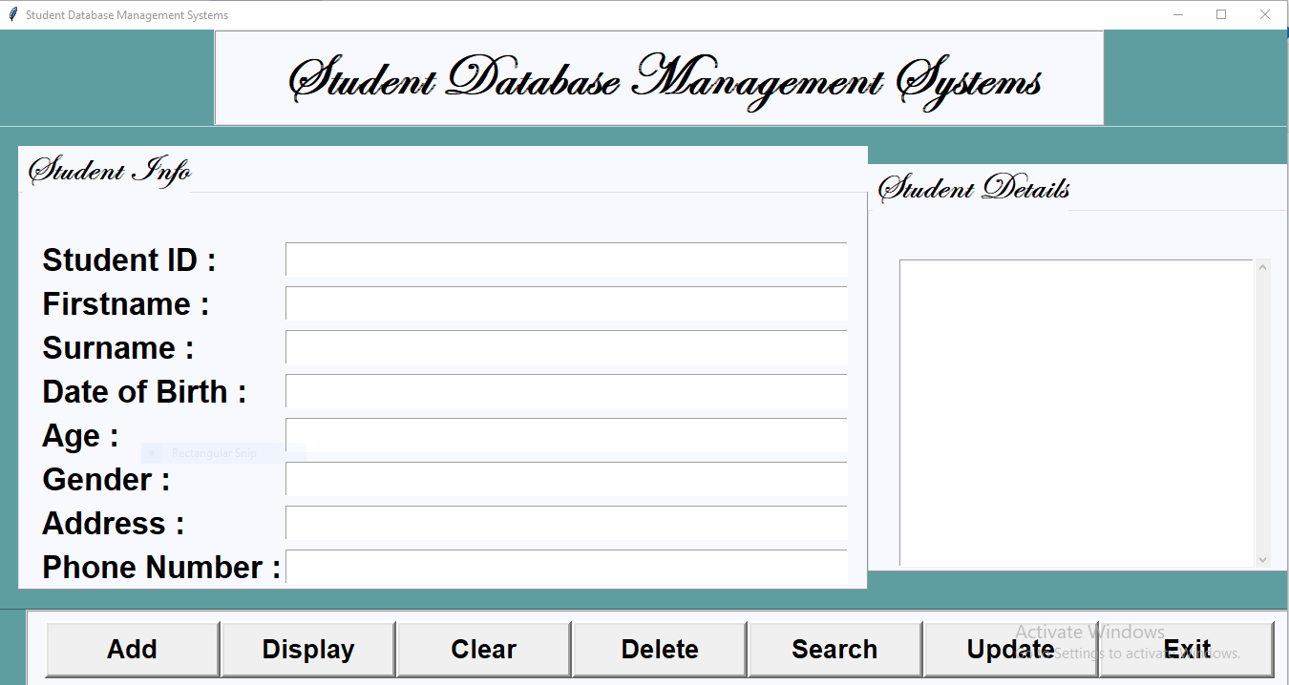
SAMPLE SCREENSHOT:

Slide 21
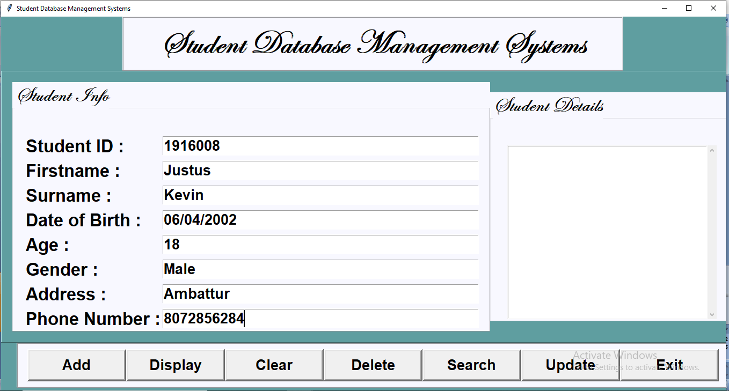
OUTPUT:
INSERTION:

Slide 22
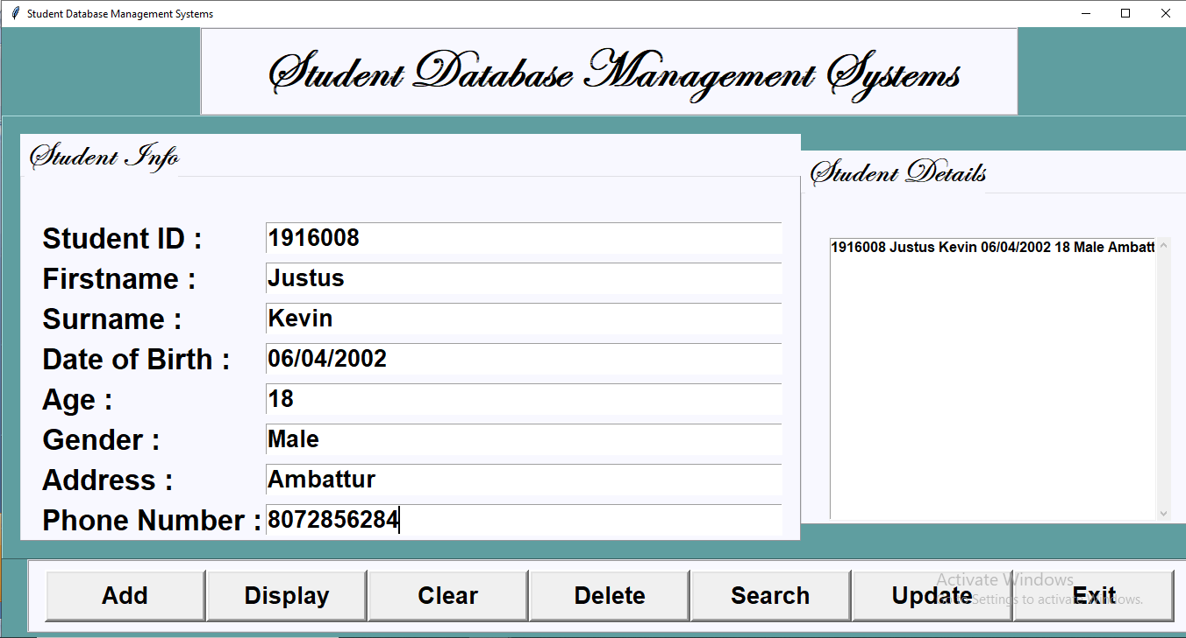

Slide 23
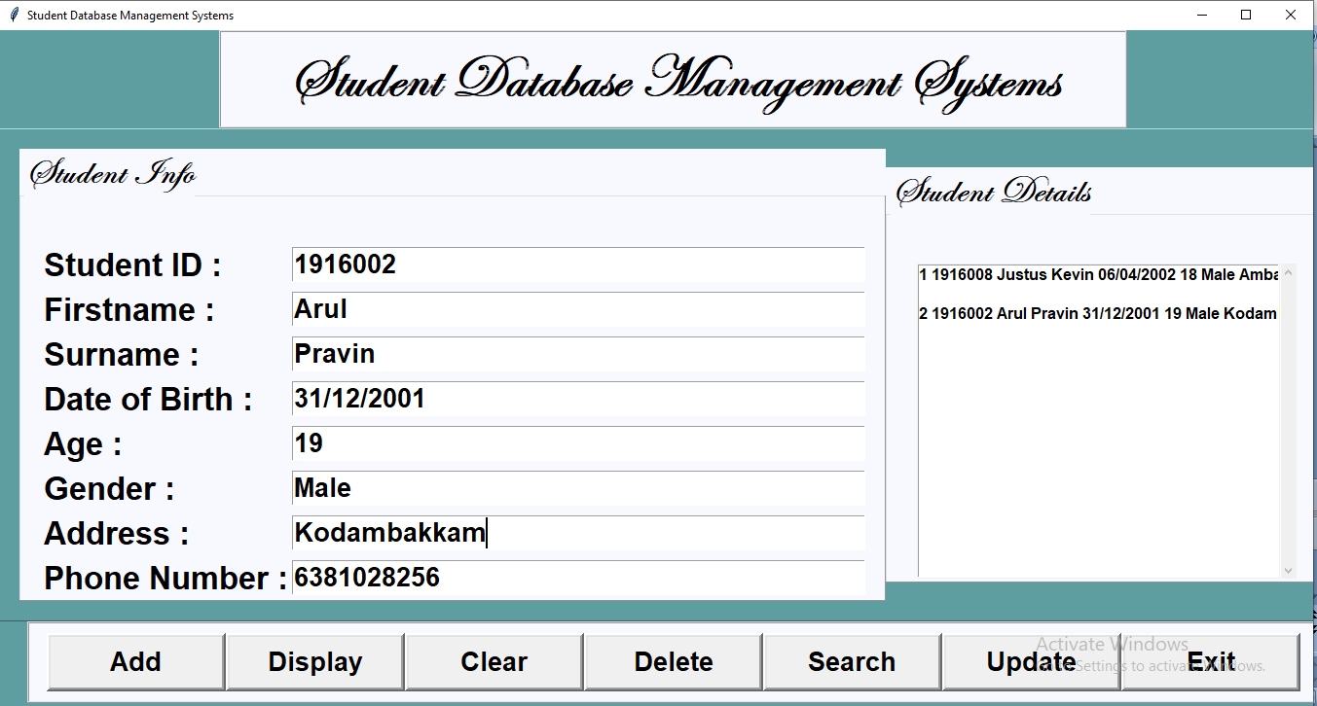
Displaying:

Slide 24
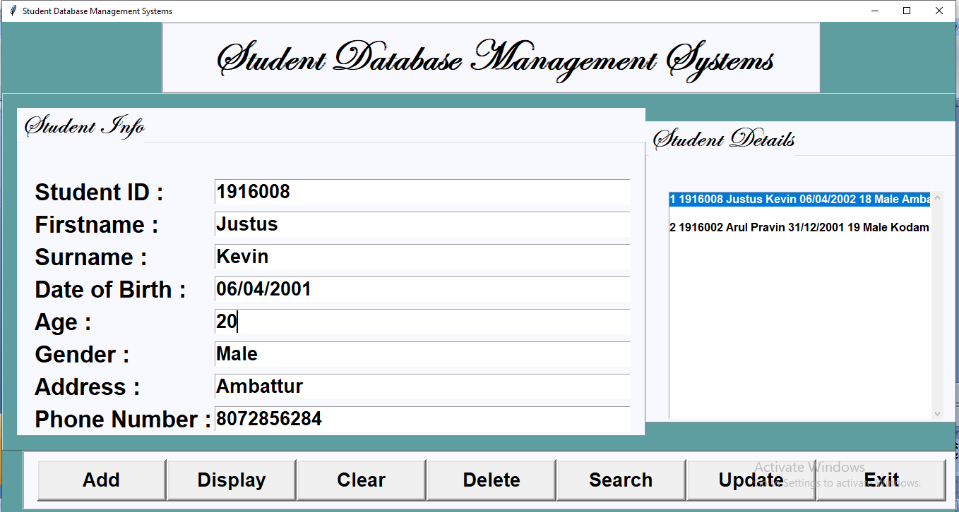
Updating:

Slide 25
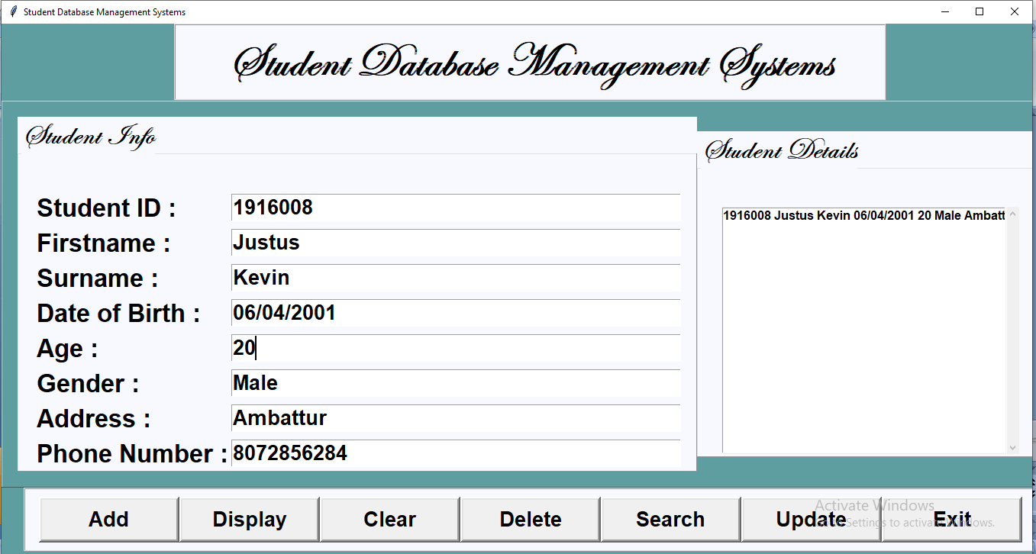

Slide 26
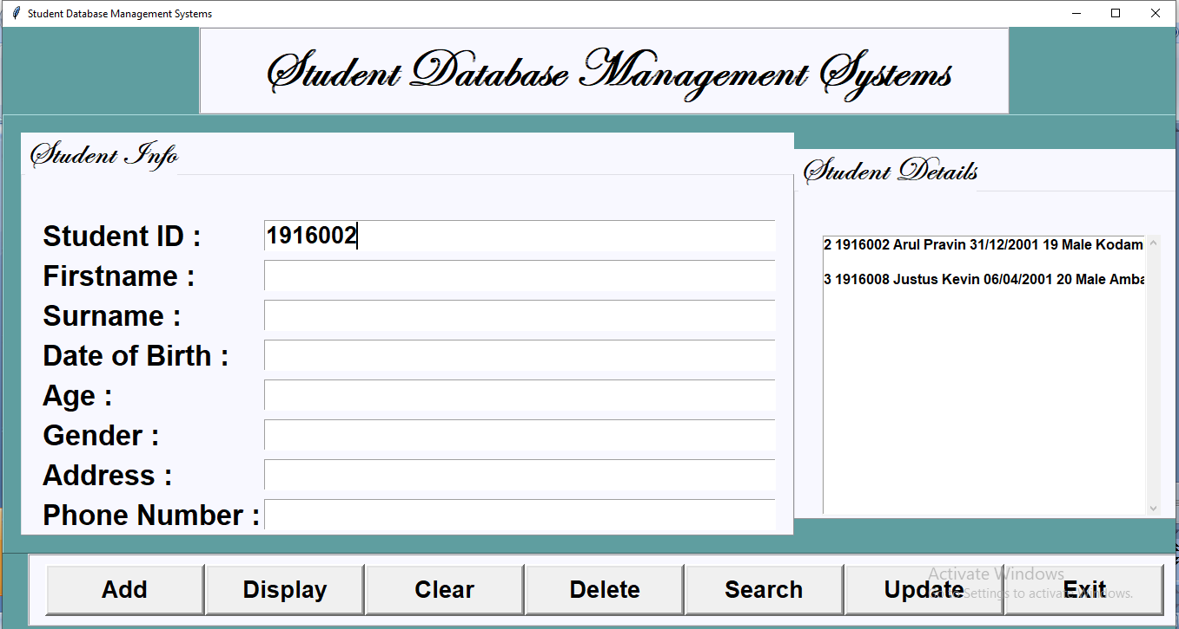
Searching:

Slide 27
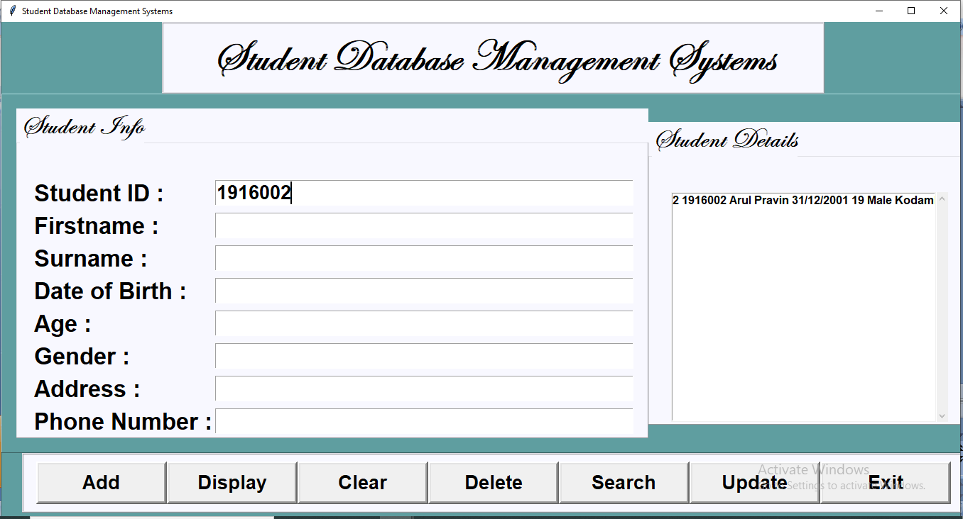
:

Slide 28
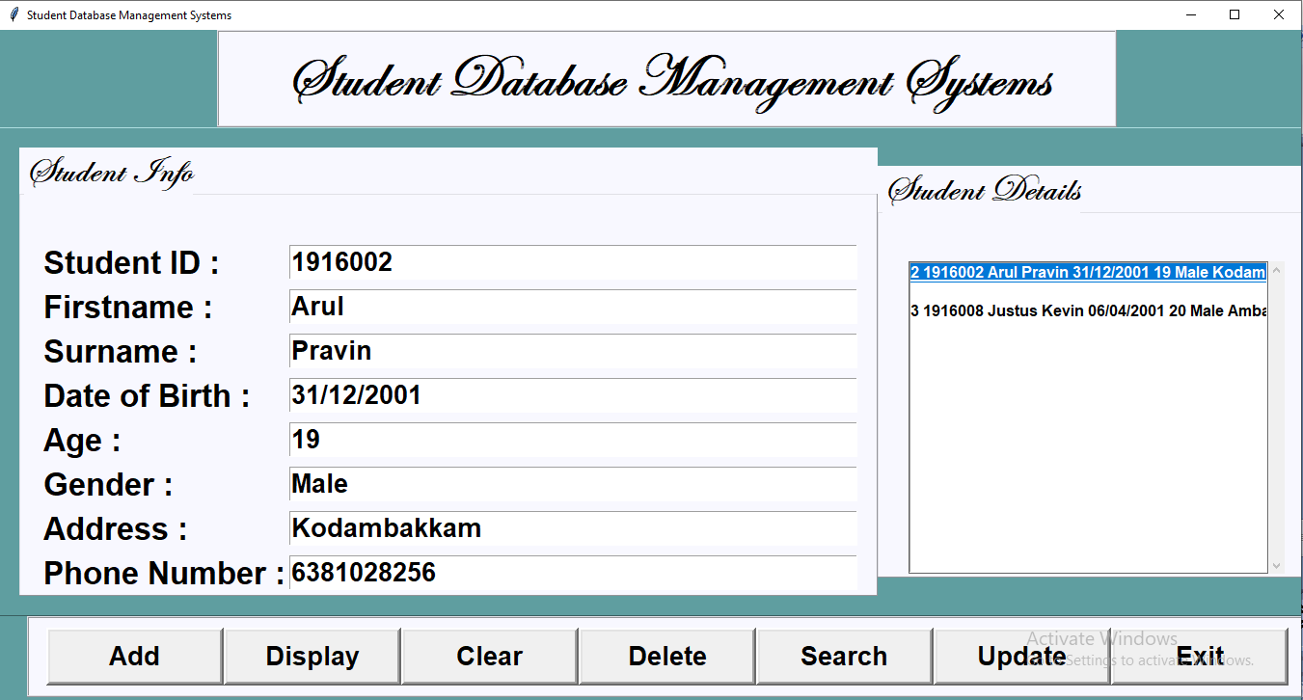
:
DELETION:

Slide 29

:

Slide 30
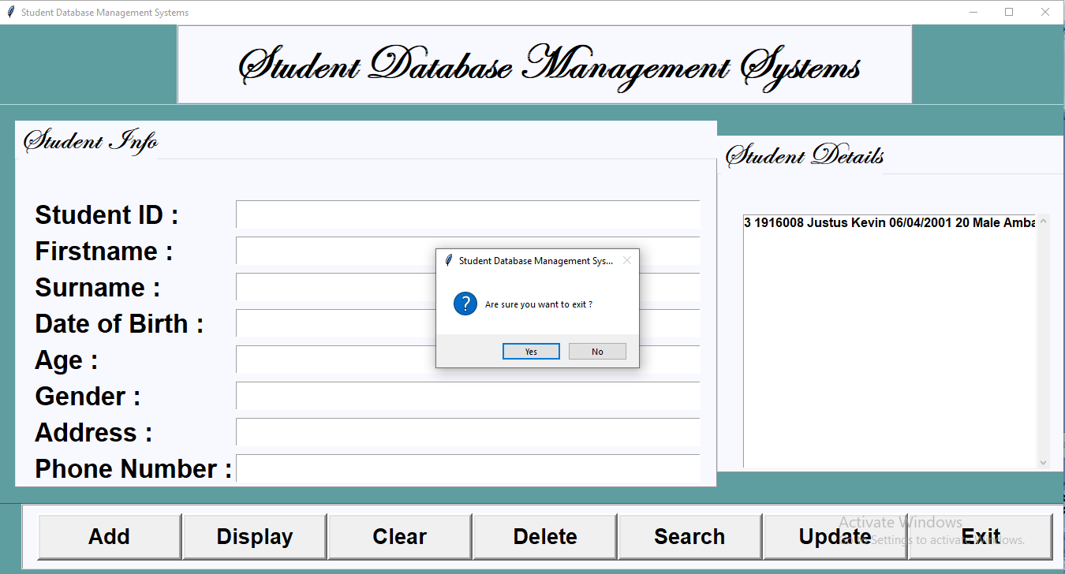
:
EXIT:

